Slide 1
Build the Enlightened Enterprise
An overview of the JBoss BPM Suite
& JBoss Fuse integration demo
Powered by Red Hat JBoss Middleware:
JBoss BPM Suite
JBoss Fuse

Slide 2
Business Challenges - Integration
Legacy applications
Departmental solutions
Cultural differences
So many protocols & standards, so little time
Support huge family of formats
Physical network limitations
Constant changes / updates / enhancements
Platform / OS variations
Collection of one-to-one links without a common infrastructure

Slide 3
Business Challenges - Automate

Slide 4
Business Challenges - Automate
Problems:
Business rules are hidden in applications – the visibility problem
It takes too long to change business rules – the agility problem
People interpret rules differently – the consistency problem
INSURANCE COMPANY
Insurance Claim

Slide 5
Solution - Red Hat JBoss BRMS

Slide 6
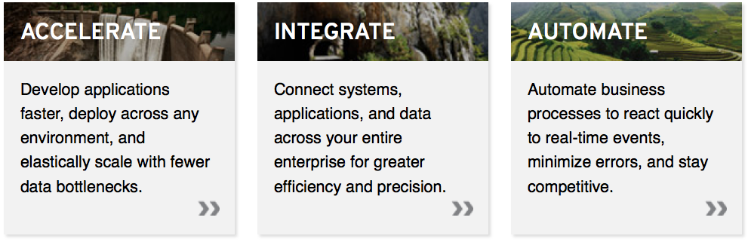
Innovate faster, in a smarter way
A family of a lightweight, enterprise-grade products that are ideal for open hybrid cloud environments.
Red Hat JBoss BRMS
Notes:
Arrow to your own product

Slide 7
The Business Rules Solution
AHA!
Rule
Repository
1. Separate the business rules
from the applications
Express rules in terms that the business can readily understand - visibility
Empower business and IT experts
to collaborate - agility
4. Automate all the rules - consistency

Slide 8
BRMS - Technology Overview

Slide 9

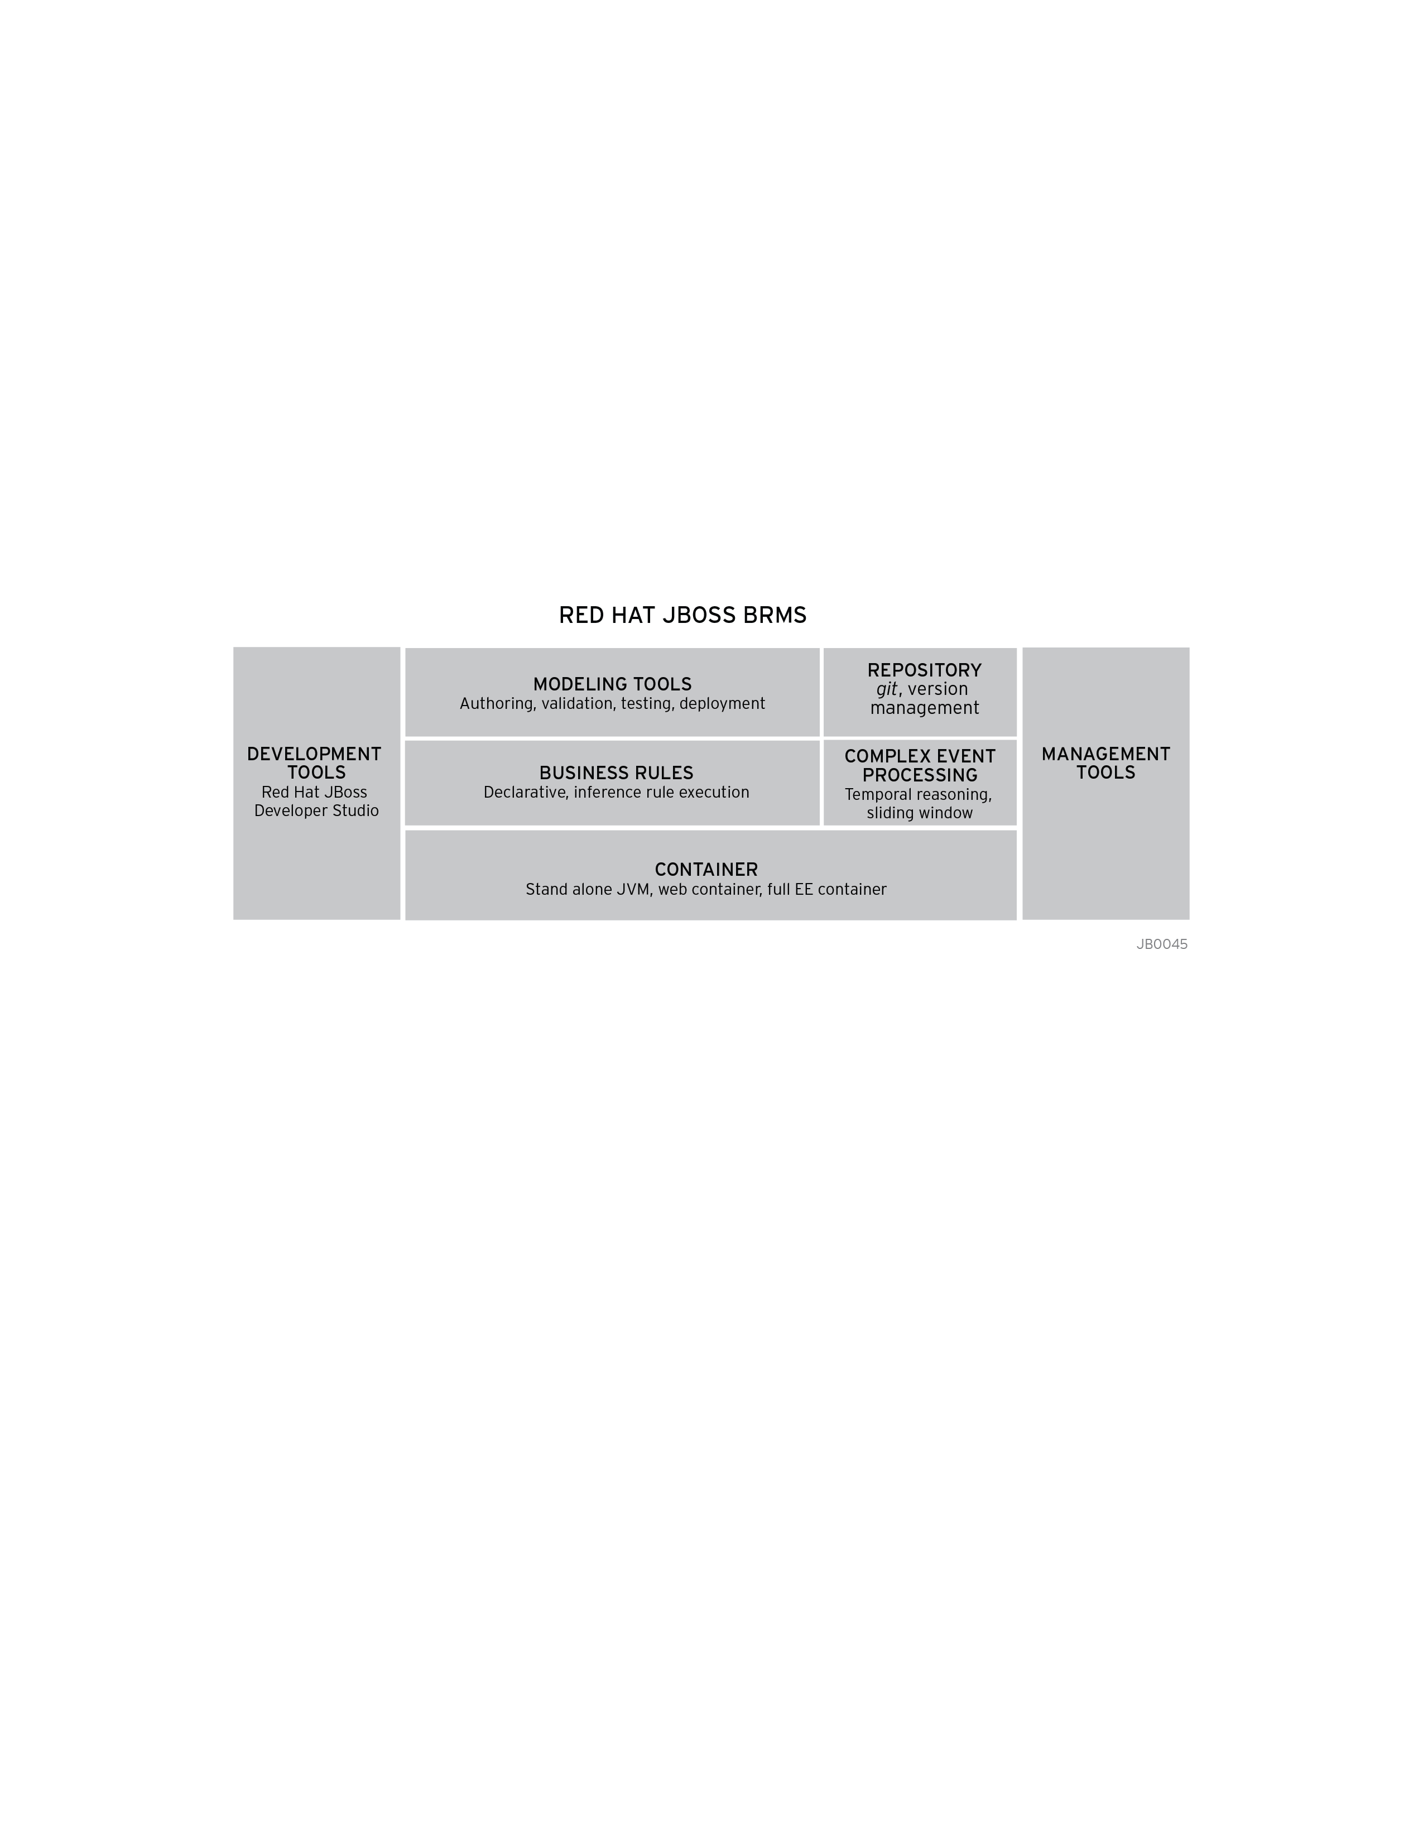
A single, integrated, certified distribution for Business Rules Management and Complex Event Processing, based on open source community projects:

Slide 10

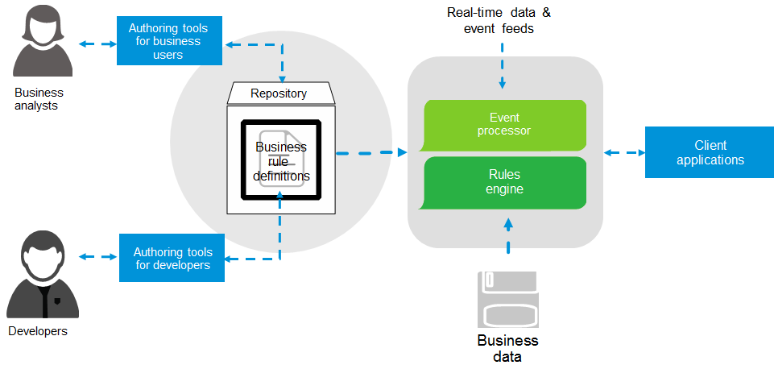
Components

Slide 11
Business Challenges - Integration

Slide 12
Business Challenges - Integration
Legacy applications
Departmental solutions
Cultural differences
So many protocols & standards, so little time
Support huge family of formats
Physical network limitations
Constant changes / updates / enhancements
Platform / OS variations
Collection of one-to-one links without a common infrastructure

Slide 13
Solution – Red Hat JBoss Fuse

Slide 14
Innovate faster, in a smarter way
A family of a lightweight, enterprise-grade products that are ideal for open hybrid cloud environments.
Red Hat JBoss Fuse

Slide 15
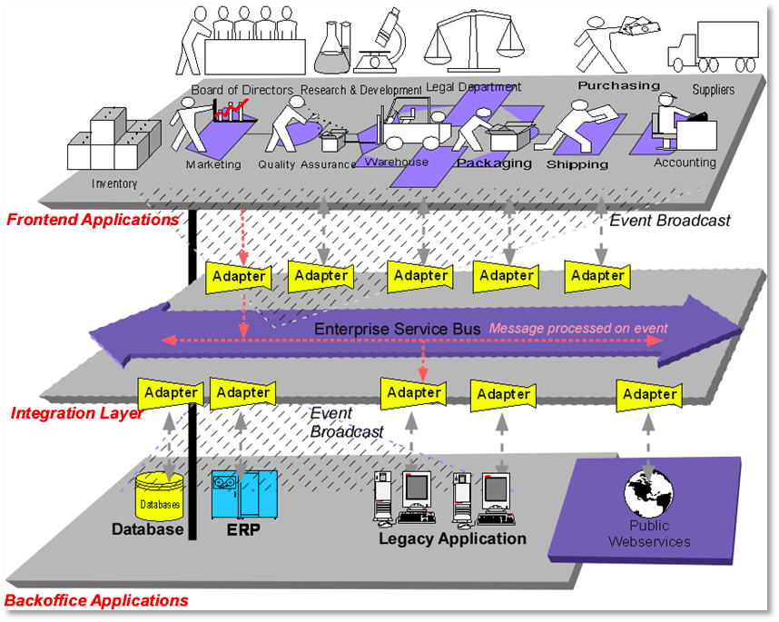
FUSE

Slide 16

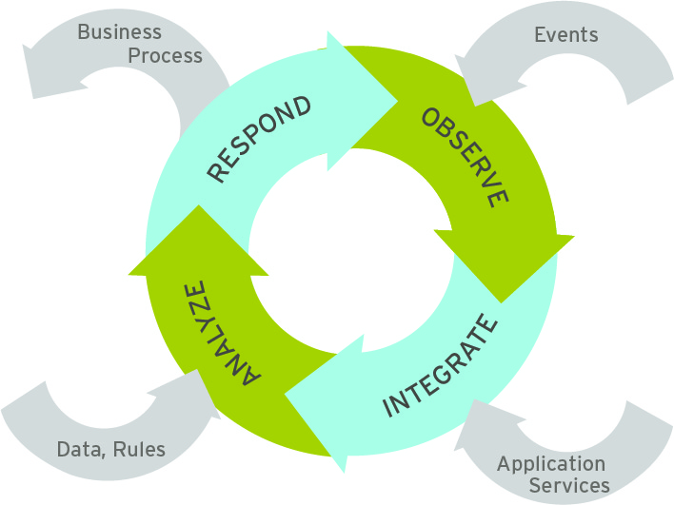

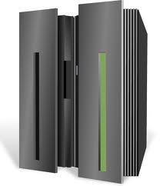
With JBoss Fuse, You Can Integrate Everything...
partners
+
outlets
HQ + integration stack
distributors
devices
Notes:
- With the JBss Fuse & JBoss A-MQ products, enterprises are no longer limited to integration at a hub or central HQ type location.
- Now enterprises can have intelligent integration with all enterprise assets extending to devices, warehouses, distributor outlets or outlets.
- Enterprises can have an ESB to integrate applications at store or distributor outlets (with its own set of technical and resource requirements) and that ESB can also integrate the store/distributor business data with central HQ.
- Enterprises can have a Messaging Platform (JBoss A-MQ) to integrate different devices, sensors, applications and services in real-time.

Slide 17
Red Hat JBoss Fuse Solution
Technology supporting existing protocols and standards
Facilitate transformation or data formatting
Integration language
Runtime to deploy services
Modularity / Granularity
Async architecture & persistence
Tools to develop, package and deploy
Supervision strategy
(Cloud) Infrastructure

Slide 18
Technology Overview

Slide 19
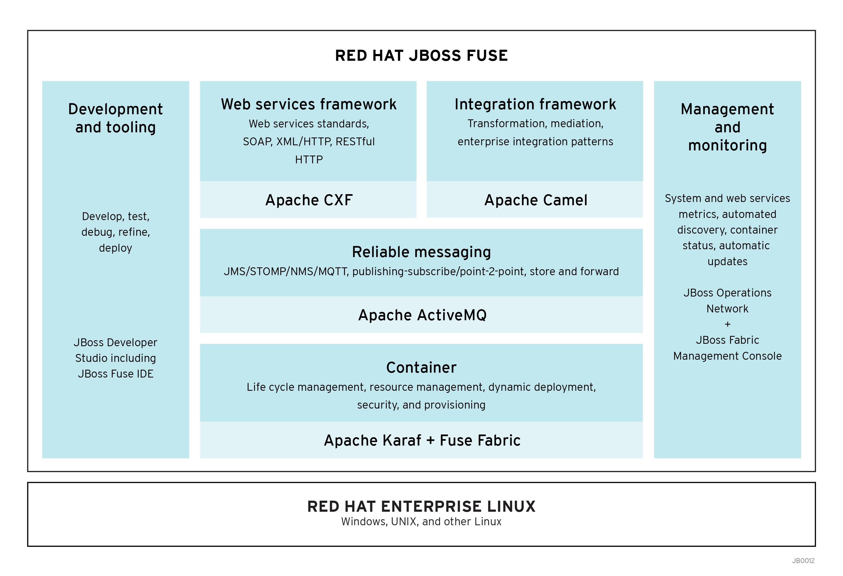
JBoss Fuse
A small-footprint, flexible, open source enterprise service bus
Enables integration everywhere for a real-time enterprise
Notes:
JBoss Fuse, a small-footprint, flexible, open source ESB
Supports integration everywhere for a real-time enterprise.
The lack of license fees combined with the ability to deploy Fuse ESB Enterprise in any configuration advances intelligent integration to all facets of the business.
Small-footprint implies smaller IT footprint, easier to manage and maintain and multiple deployment options (distributed, embedded). Small footprint does not imply any negative performance implications like lower performance. JBoss Fuse is a proven and high-performance messaging platform.

Slide 20
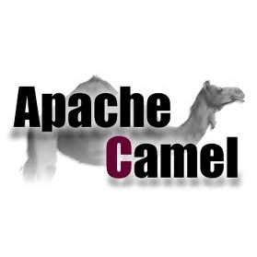
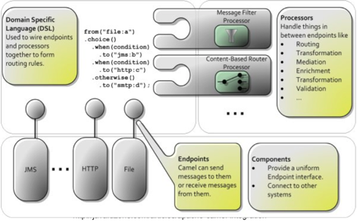

Slide 21
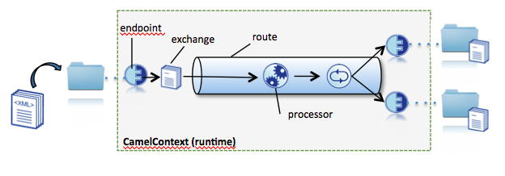
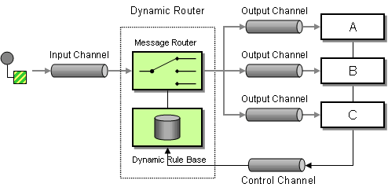

Slide 22
BRMS + Fuse = Enterprise Automation and Integration

Slide 23
Use Case
Financial Services
  Large bank is looking to modernize a main frame system
  Trading orders, compliance, account management, asset transfer, books and records, etc
  Must Integrate with legacy mainframe into foreseeable future
Government / Regulation / Insurance
  Tend to process documents with extremely large business domains
  Multitude of associated rules and process
  Often slow to change due to complexity
Telecommunications
  Looking to collect and process events from across the enterprise
  Drive new business capabilities with real-time data analysis and response

Slide 24
Approaches
Embedded
  Call rule, process or Complex Event processing engine embedded in camel route
  Benefit of calling engine in-VM with lower overhead
  Consolidated operations with Fuse Fabric control only
  Best for stateless engine usage
Service
  Call rule decision service
  Benefit from independent scaling from integration deployments
  Best for stateful rule service

Slide 25
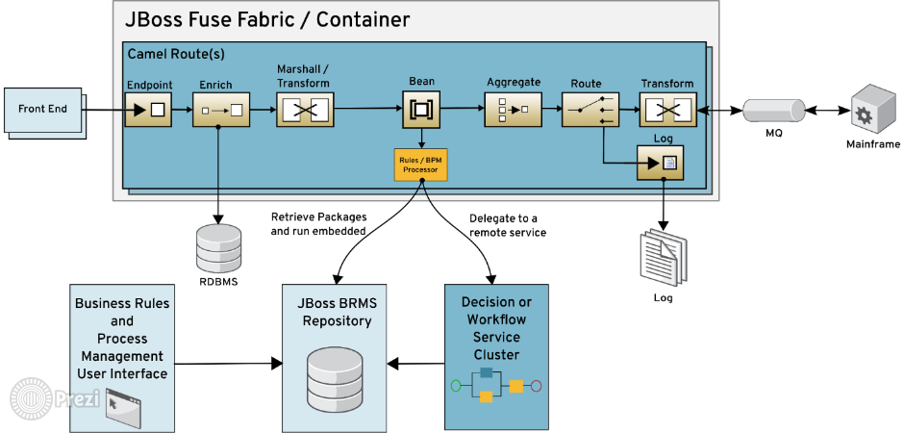

Slide 26
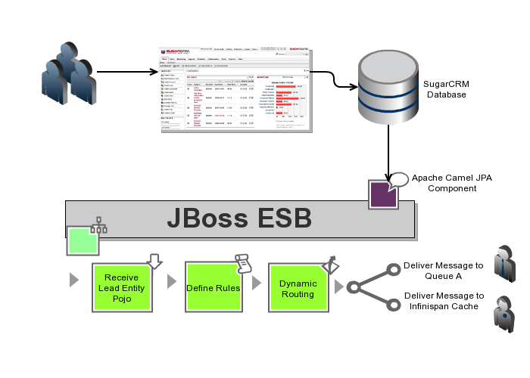
Red Hat JBoss Fuse

Slide 27
Build the Enlightened Enterprise
For more information, please visit: http://www.jboss.org/products/bpmsuite http://www.jboss.org/products/fuse
Demo available at: http://github.com/eschabell/bpms-fuse-integration-demo

